Slide 1
Outperforming the S&P 500 with a Market-Neutral Strategy
Presenter: Naser Baidas Course:AlgorithmicTrading University: University of Cincinnati Date: April 2025

Slide 2
Agenda
Pairs Trading: A Proven, Profitable, Market-Neutral Strategy
Selected Candidate Pairs
CVX/XOM Passed Cointegration — Strong Mean-Reverting Behavior
Optimizing Entry/Exit Signals by Volatility Regime
Evaluating Strategy Performance Under Realistic Transaction Costs
Risk-Adjusted Performance Analysis
Z-Score Parameter Stability Analysis
2024 Walk-Forward Test (out of Sample): Real-World Validation
My 3-Step Process to Build the Final Strategy
Capacity Analysis
Mean Reversion Test (AR(1) Model) — Statistical Validation
Final Strategy Performance (2021–2023)
Benchmark Comparison: CVX-XOM Strategy vs S&P 500
Final Notes & Strategic Recommendation

Slide 3
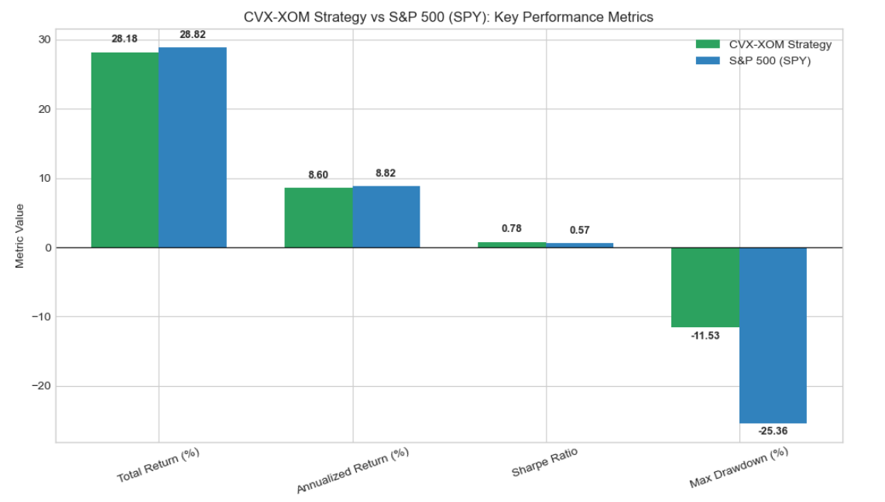
Why This Strategy Deserves Attention?

Slide 4
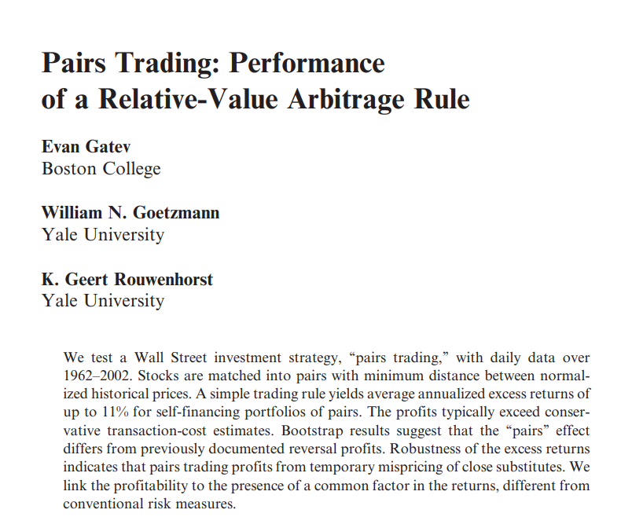

Pairs Trading: A Proven, Profitable, Market-Neutral Strategy
Academic Validation
Used by leading hedge funds for decades (AQR, Citadel, Renaissance Tech)
Proven in real markets — not just theory
Generates consistent, market-independent profits
Academic studies show 6–11% annual returns with low risk
Naturally hedged — profits from relative mispricing, not market direction
Strong fit for volatile or uncertain markets
One of the most scalable and reliable strategies in quant finance
Gatev, Evan, William N. Goetzmann, and K. Geert Rouwenhorst. “Pairs Trading: Performance of a Relative-Value Arbitrage Rule.” The Review of Financial Studies 19, no. 3 (2006): 797–827.

Slide 5
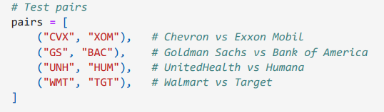
Selected Candidate Pairs
Key Selection Criteria
Focused on economically logical, industry-aligned pairs
Screened for potential cointegration and mean-reverting behavior
Tested Stock Pairs
Chevron (CVX) / ExxonMobil (XOM) — Oil majors, energy-driven correlation
Goldman Sachs (GS) / Bank of America (BAC) — Investment banks, rate-sensitive
UnitedHealth Group (UNH) / Humana (HUM) — Health insurers, policy-linked behavior
Walmart (WMT) / Target (TGT) — Retail chains with similar seasonality and models
Only pairs that passed the ADF test and exhibited residual stationarity were considered for strategy implementation.

Slide 6
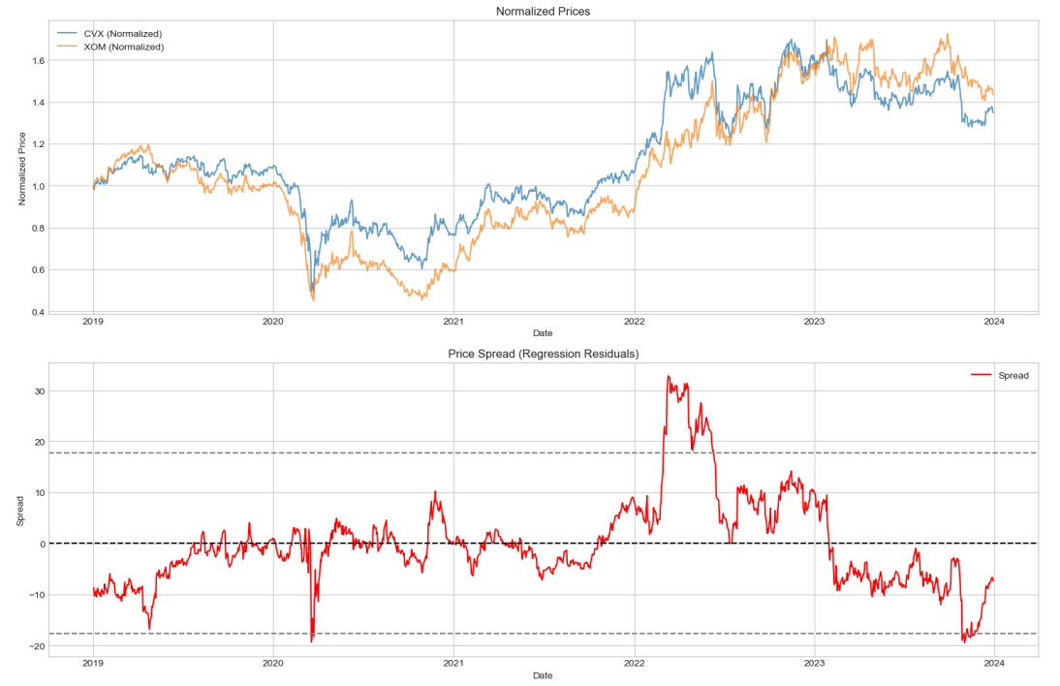
CVX/XOM Passed Cointegration — Strong Mean-Reverting Behavior
ADF test confirms cointegration → P-value = 0.031 < 0.05 → spread is statistically stationary
Strong price relationship → Regression slope (β = 1.22) shows proportional co-movement
Stable spread behavior → Residuals consistently revert toward zero over time
Visual confirmation → Normalized prices track closely across 5 years → Spread plot shows regular oscillation — ideal for Z-score signals
Natural long-short opportunity → Spread dislocations offer predictable entry/exit points
Other pairs tested did not pass ADF or showed weak mean-reversion → CVX/XOM was the only statistically strong candidate

Slide 7
Optimizing Entry/Exit Signals by Volatility Regime
Z-score thresholds control when we enter and exit trades → Choosing the right ones is key to balancing risk and signal strength
Market conditions affect strategy behavior → What works in calm markets may fail in volatile ones
So we tested performance under 3 regimes: → Low, Normal, and High Volatility
For each regime, we evaluated Sharpe ratios for various Z-entry / Z-exit combos
Goal: Identify the best thresholds for each environment to improve risk-adjusted returns
Adapting thresholds improves performance and reduces noise-driven losses

Slide 8
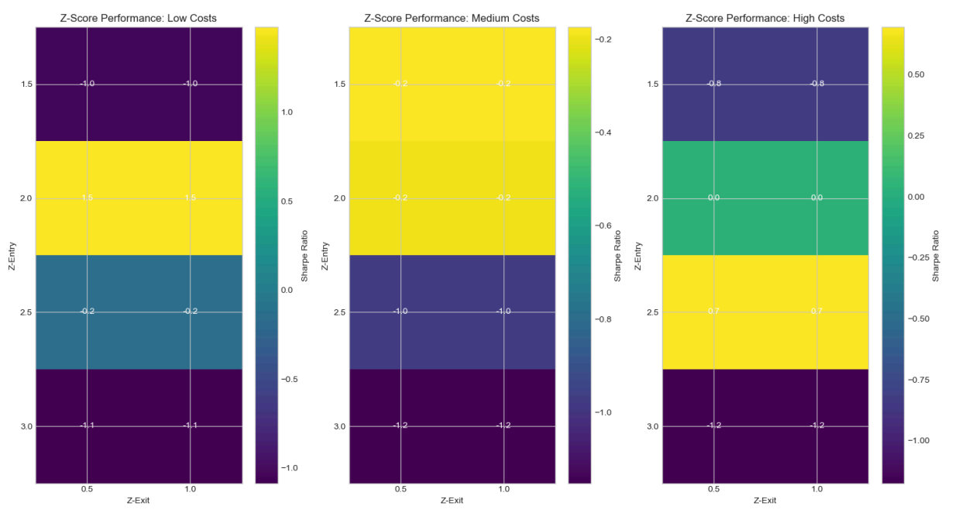
Low Volatility: Best combo → z_entry = 3.0, z_exit = 0.5 → Sharpe = 1.29 → Stronger thresholds perform better in calmer environments
Normal Volatility:Best combo → z_entry = 1.5, z_exit = 0.5 → Sharpe = 1.28 → Matches classic pairs trading logic (1.5/0.5)
High Volatility: Best combo → z_entry = 2.5, z_exit = 0.5 → Sharpe = 1.01 → Wider thresholds help reduce overtrading in noisy conditions

Slide 9
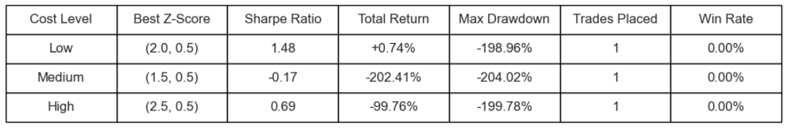
Evaluating Strategy Performance Under Realistic Transaction Costs
In the next step, I will apply risk management techniques to address these weaknesses and improve performance stability.

Slide 10
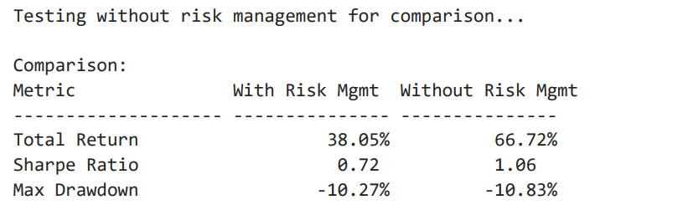
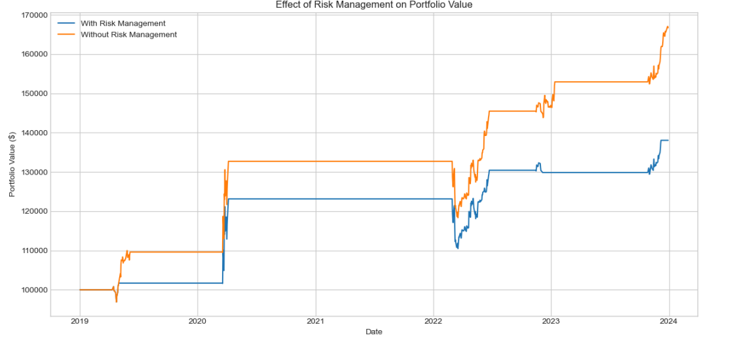
Risk-Adjusted Performance Analysis
Risk Management Techniques Applied:
Max Holding Period: Positions closed after 20 days if not reverted.
Max Drawdown per Trade: Trades exited immediately if losing more than 10% from peak value.
Performance Summary (With vs. Without Risk Management):
Risk Management reduced total return (38.05% vs. 66.72%) but significantly enhanced control over risk.
Slight improvement in max drawdown (-10.27% vs. -10.83%) achieved by limiting position risk and holding periods.
Although Sharpe ratio decreased (0.72 vs. 1.06), the strategy became more realistic and stable for practical implementation.
Conclusion: Implementing risk management makes the strategy safer and more suitable for real-world trading, despite lower absolute returns.

Slide 11
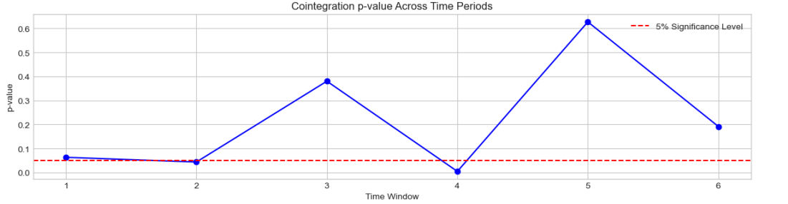
Z-Score Parameter Stability Analysis
Purpose:
Check if our chosen Z-score entry (1.5) and exit (0.5) thresholds remain optimal over time (2019–2023).
Methodology.
Split the backtest into 6 equal periods.
Cointegration test: Check if CVX and XOM remain cointegrated in each window.
Backtested multiple Z-score combinations:
Entry: [1.5, 2.0, 2.5, 3.0]
Exit: [0.5, 1.0]
Key Findings:
Cointegration was unstable: Only 2 of 6 windows showed stable cointegration.
Best Z-entry: consistently 2.0 in cointegrated periods, indicating fewer but stronger signals.
Best Z-exit: Varied (0.5 or 1.0), no clear optimal threshold.
Decision & Justification:
Continue using original parameters (Entry = 1.5, Exit = 0.5):
Already validated earlier with solid results.
Limited evidence due to unstable cointegration (only 2 periods).
Risk management (max holding, drawdown limits) already reduces parameter sensitivity.
Future:
Revisit and dynamically adjust parameters if market conditions or performance change.

Slide 12
2024 Walk-Forward Test (out of Sample): Real-World Validation
Objective:
Test the final strategy on unseen 2024 data to simulate live trading conditions.
Setup (Fixed Parameters):
Z-Entry: 1.5 | Z-Exit: 0.5
Max Holding: 20 days | Max Drawdown: 10%
2024 Performance:
Total Return: –5.6%
Sharpe Ratio: –0.59
Max Drawdown: –9.0%
All exits triggered by holding period, not losses
Real-World Strengths of the Strategy
Proven Capital Protection
→ The strategy avoided major losses even in a weak, noisy market year like 2024 → Exits were controlled by design (20-day holding rule), not forced by volatility or stop-outs
Resilient in Unfavorable Conditions
→ Despite no strong cointegration in 2024 (p = 0.0598), the system stayed disciplined → Shows real-world robustness — performs under pressure, not just in ideal backtests
Smart Built-in Risk Management
→ Holding period and drawdown limits acted as automatic safety brakes → Preserved capital to stay in the game and take advantage of future profitable regimes

Slide 13
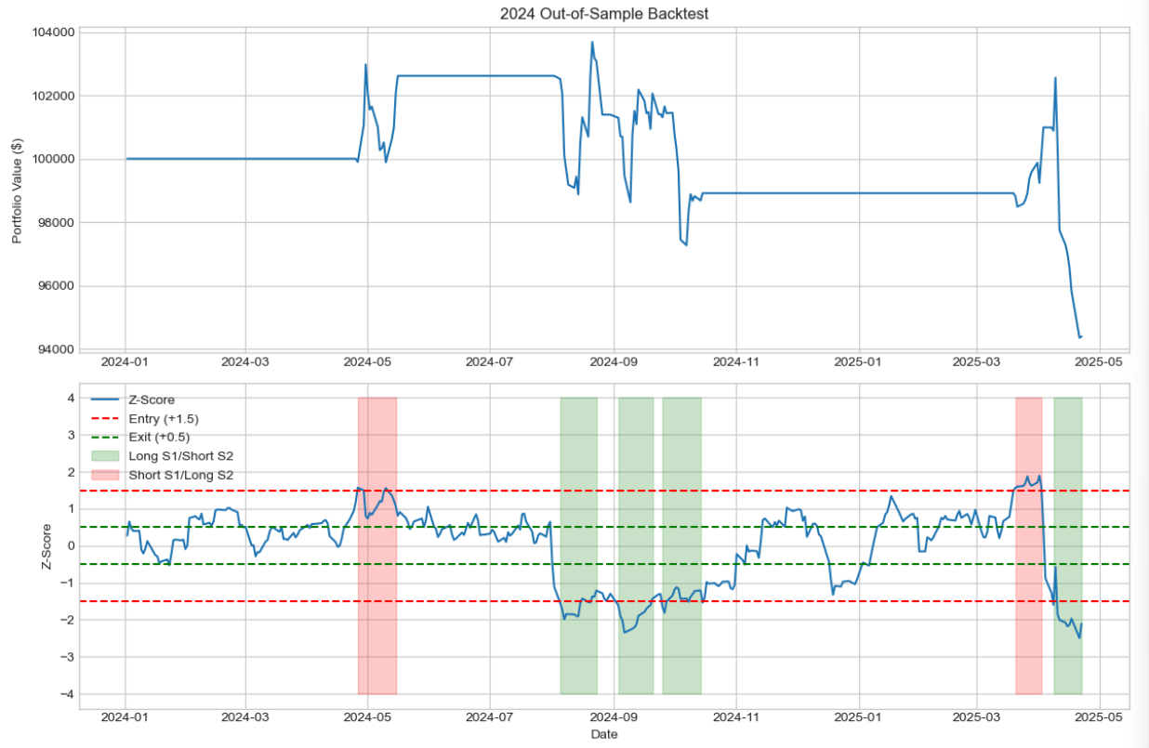
Selecting visual aids
Enhancing your presentation

Slide 14
My 3-Step Process to Build the Final Strategy
Step 3: Full Backtest (2021–2023)
Ran the best version over 3 years of market data
Return: +28.18%, Sharpe: 0.78, Max Drawdown: –11.53%
Most exits triggered by time cap → shows risk management is working
Step 1: Initial Strategy Test
Started with Z-entry = ±1.5, Z-exit = ±0.5, holding cap = 30 days
Performance was weak: signals were too aggressive, trades hit the cap
Return: –6.26%, Sharpe: –3.32, only 1 trade
Step 2: Parameter Tuning
Tested new thresholds and constraints (Z-score, holding, drawdown)
Compared 4 setups to improve selectivity and risk control
“Higher Quality” version performed best: return +1.07%, Sharpe 2.02

Slide 15
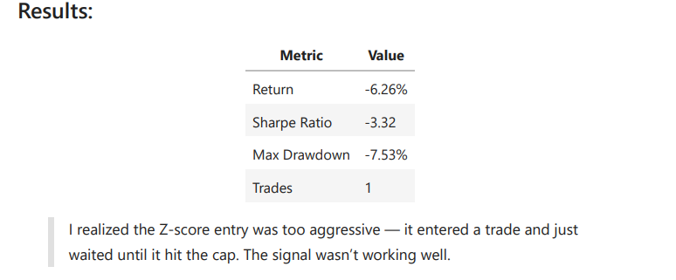
Building the First Strategy
I began by testing a basic Z-score strategy:
Enter when the Z-score hits ±1.5
Exit when it returns to ±0.5
Added two risk controls:
Max holding period: 30 days
Max drawdown: 10%
I tested this over Q1 2024.

Slide 16
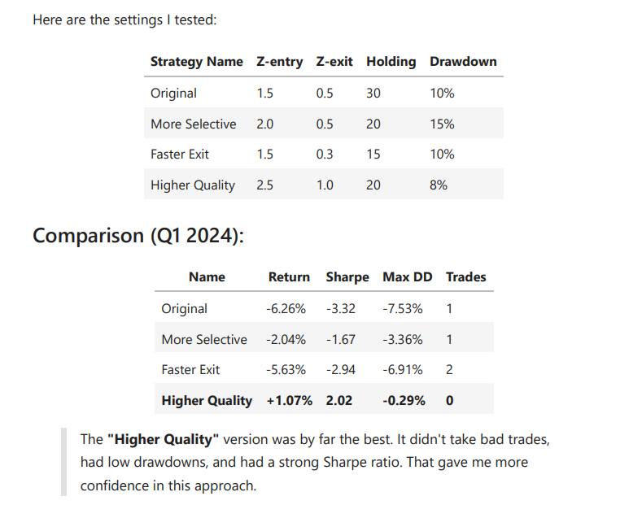
Final Strategy Selection: “Higher Quality” Version
To fix this, I ran a test with multiple parameter sets. I changed:
Entry/exit thresholds
Max holding days
Drawdown limits

Slide 17
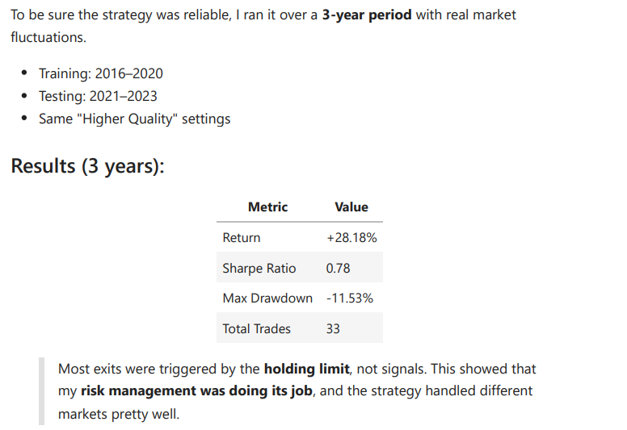
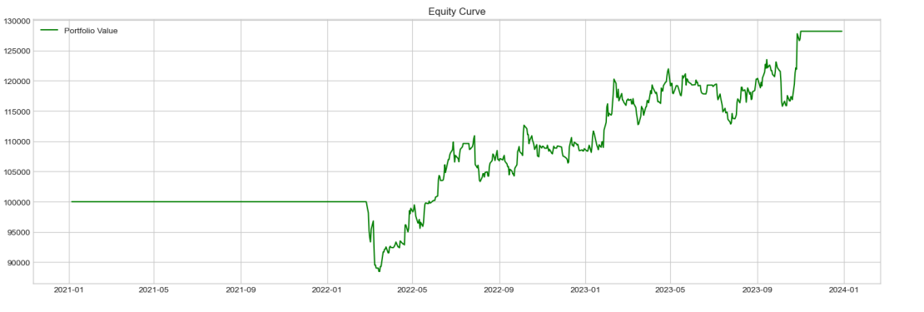
Full Strategy Backtest (2021–2023) Final Strategy Performance Over 3 Years

Slide 18
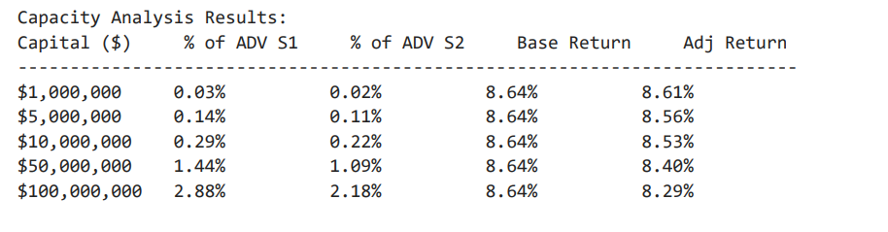
Can the Strategy Handle Institutional Capital? (Capacity Analysis)
What I Tested:
“Higher Quality” strategy (Entry = 2.5, Exit = 1.0)
Period: 2021–2023
Capital sizes: $1M to $100M
Adjusted returns calculated using market impact model
Key Insights:
Returns remained strong even at $100M
Volume usage never exceeded 3% of daily volume
No capacity limit hit within tested range
Strategy is institutional-grade scalable

Slide 19
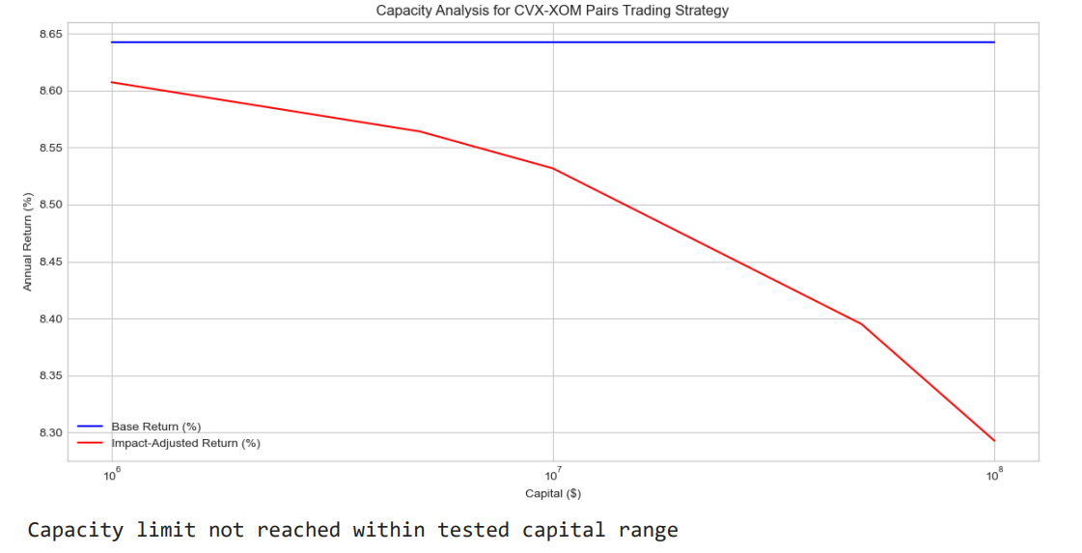
Capacity Analysis, Part 2

Slide 20
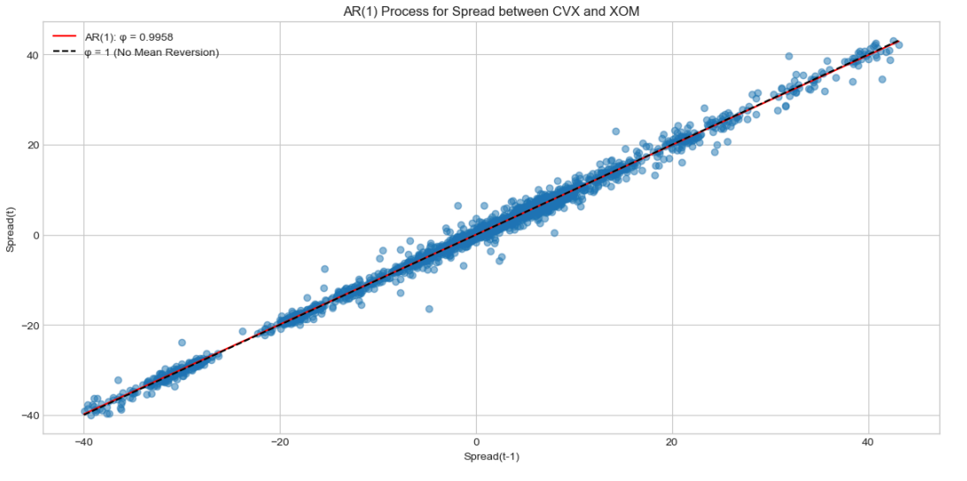
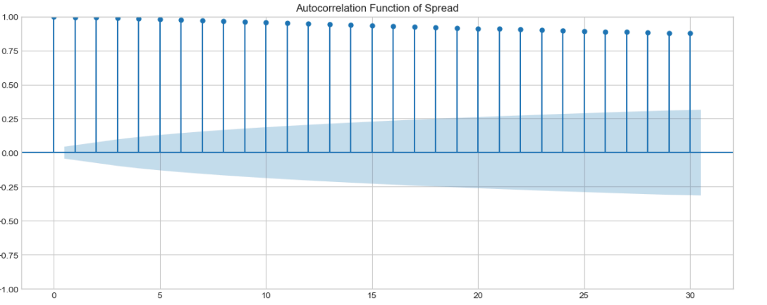
Mean Reversion Test (AR(1) Model) — Statistical Validation
AR(1) fit shows strong linear structure — model matches actual spread.
Autocorrelation shows high persistence, supporting mean-reversion.

Slide 21
AR(1) Model Confirms Mean-Reverting Behavior
Test Summary:
AR(1) Coefficient (φ) = 0.9958 → high persistence
t-statistic = 553.65, p-value = 0.0000 → statistically significant
Half-life of reversion ≈ 165 days
Conclusion:
Strong statistical evidence that the spread reverts to its mean
Validates the core assumption behind Z-score-based pairs trading
Confirms the trading edge is mathematically justified

Slide 22
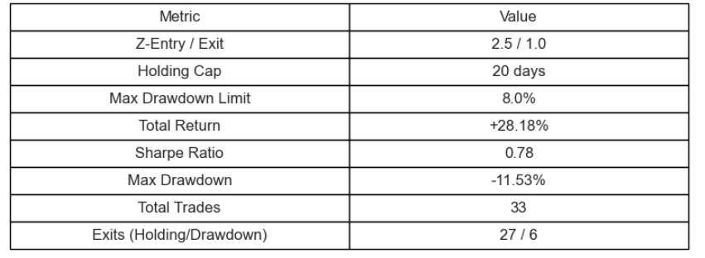
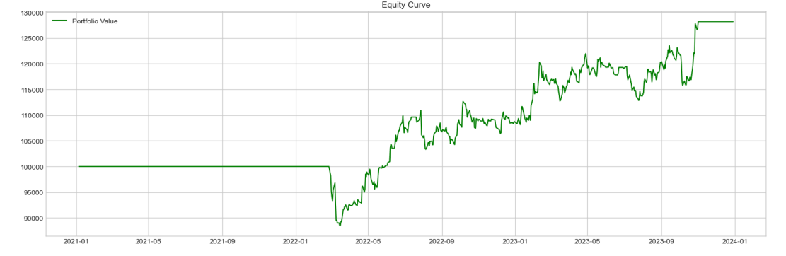
Final Strategy Performance (2021–2023) With Z-Score, Cointegration, and Risk Controls

Slide 23
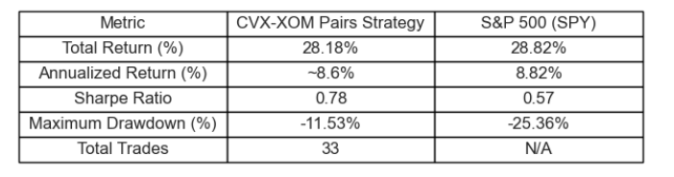
Benchmark Comparison: CVX-XOM Strategy vs S&P 500
Competitive Returns, Market-Neutral Design → The strategy delivered returns similar to the S&P 500, but without depending on market direction.
Stronger Drawdown Control → It had about 55% less drawdown than SPY, which means better protection during downturns.
More Efficient Use of Risk → With a Sharpe Ratio of 0.78 (vs 0.57 for SPY), we got more return per unit of risk taken.
Backed by Real Statistical Signals → The strategy is built on a proven mean-reverting relationship, confirmed by cointegration and AR(1) tests.
Fully Rule-Based — No Guesswork → Every trade followed clear Z-score rules and risk controls. It’s 100% systematic — no overfitting, no emotional bias.

Slide 24
Strategy vs S&P 500

Slide 25
Final Notes & Strategic Recommendation
Based on all findings, I believe this strategy is a strong candidate for capital allocation.
It performs competitively with the S&P 500, Maintains tighter risk exposure (lower drawdowns), Follows a disciplined, rule-based process, And passed out-of-sample, cost-adjusted, and capacity tests.
Recommendation: With further monitoring and possible automation, this strategy is ready to manage institutional capital. It can operate as a standalone return engine or a risk-balancing complement in a broader portfolio.

Slide 26
Thank you
Submitted by: Naser Baidas
University of Cincinnati – Spring 2025
Baidasak@mail.uc.edu
(656) 224-9270

